Slide 1
aiPiCar DGMD FALL 2019 PROJECT
Building a Self-Driving Raspberry Pi Car Capable of Lane Following, Object Recognitions and Obstacle Avoidance
Project By: Alex Andony
https://github.com/ando11235/aiPiCar

Slide 2
Project Overview
The goal of this project is to demonstrate self-driving autonomous technological concepts using a small Robotic Car powered by a Raspberry Pi, at a price tag under $400.
Assemble the PiCar Kit and Base Raspberry Pi Operating System
Demonstrate Autonomous “Lane Following” through OpenCV
Demonstrate Advanced Camera recognition features, including adapting to street signs and basic obstacle avoidance
Put everything together, demonstrating a real world application scenario involving both lane following and object recognition

Slide 3
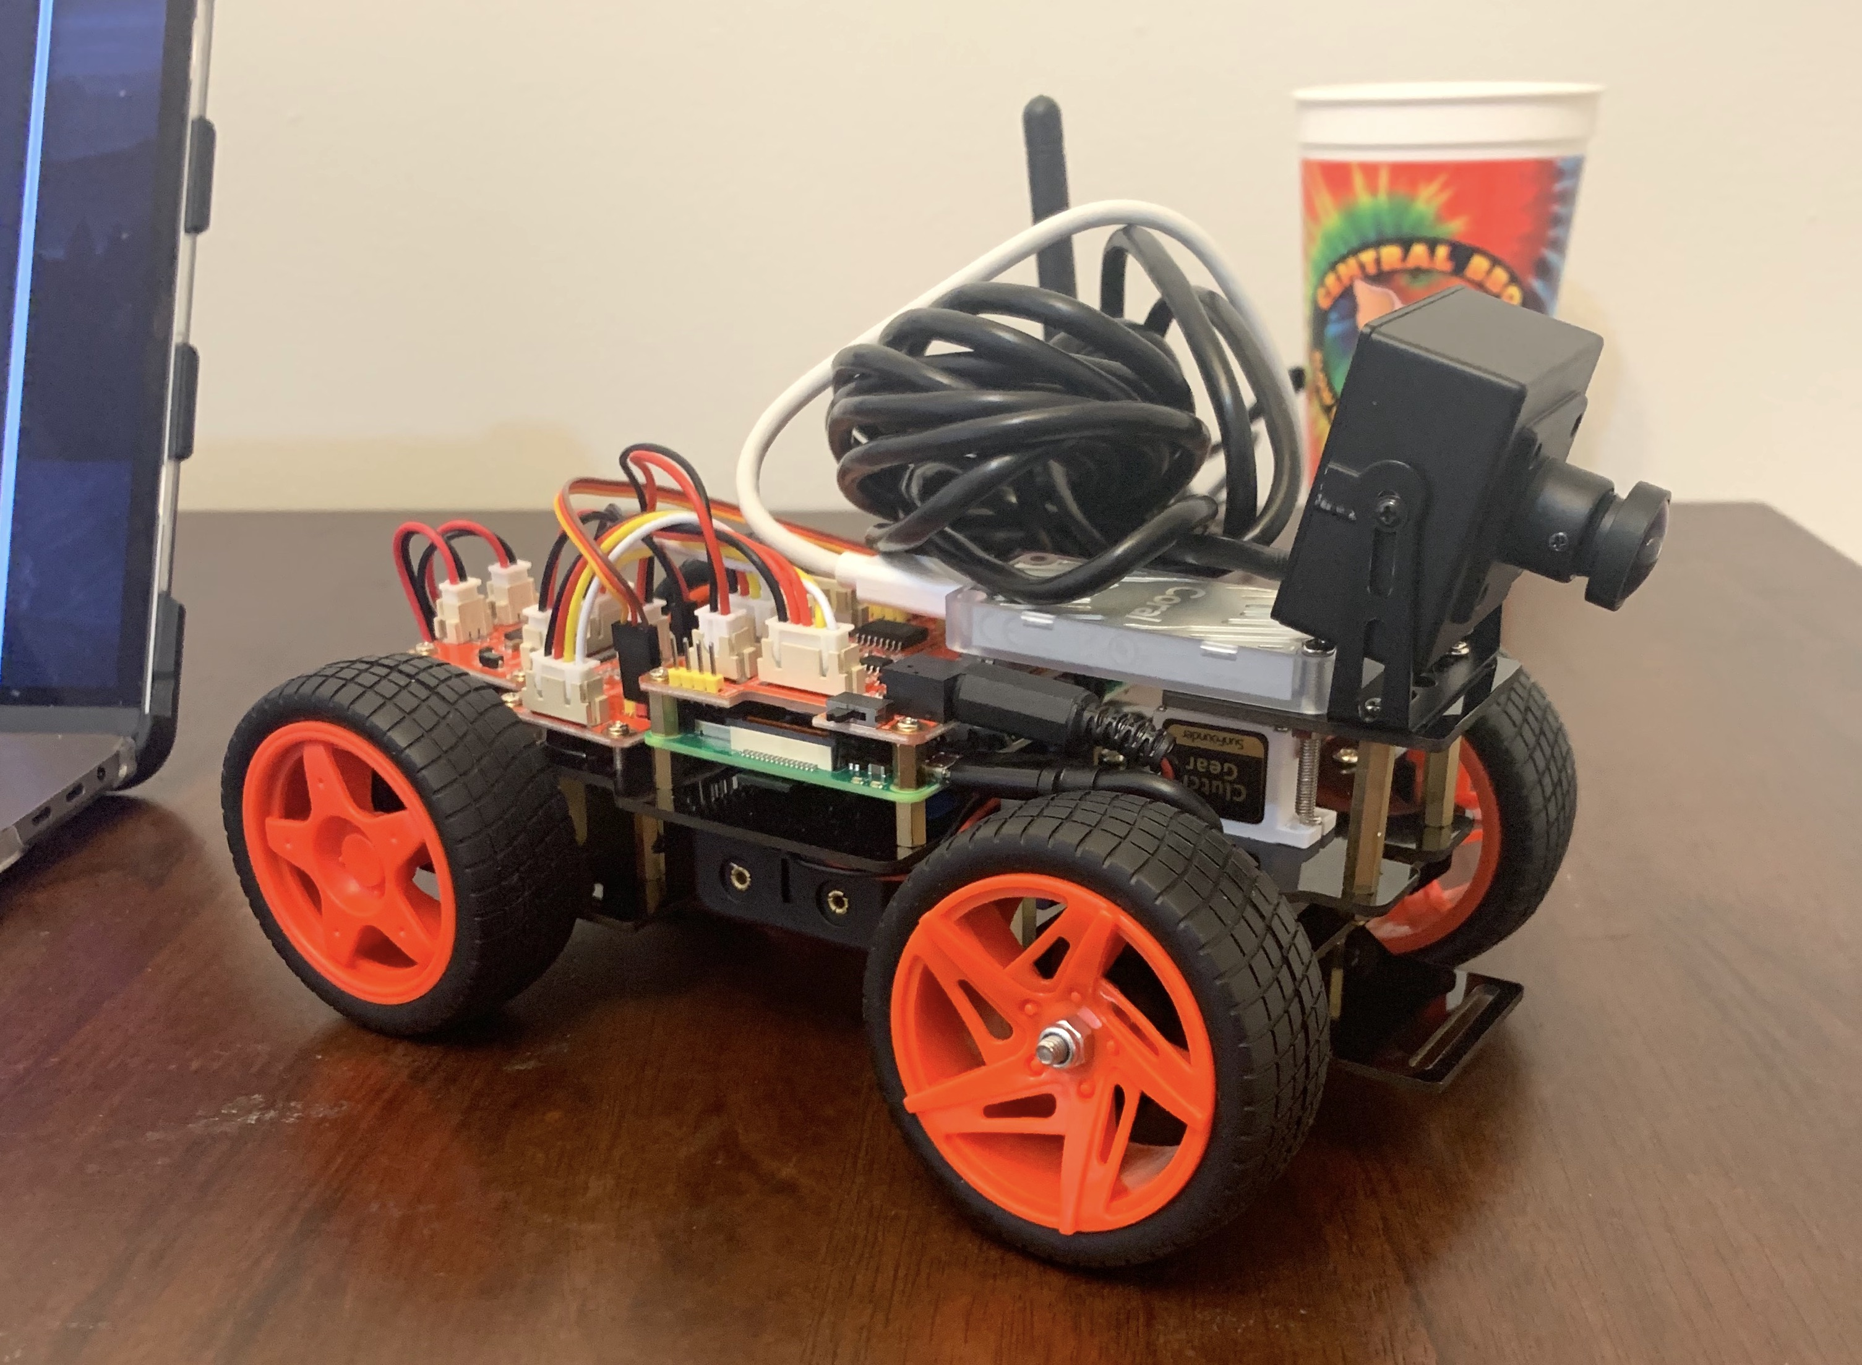
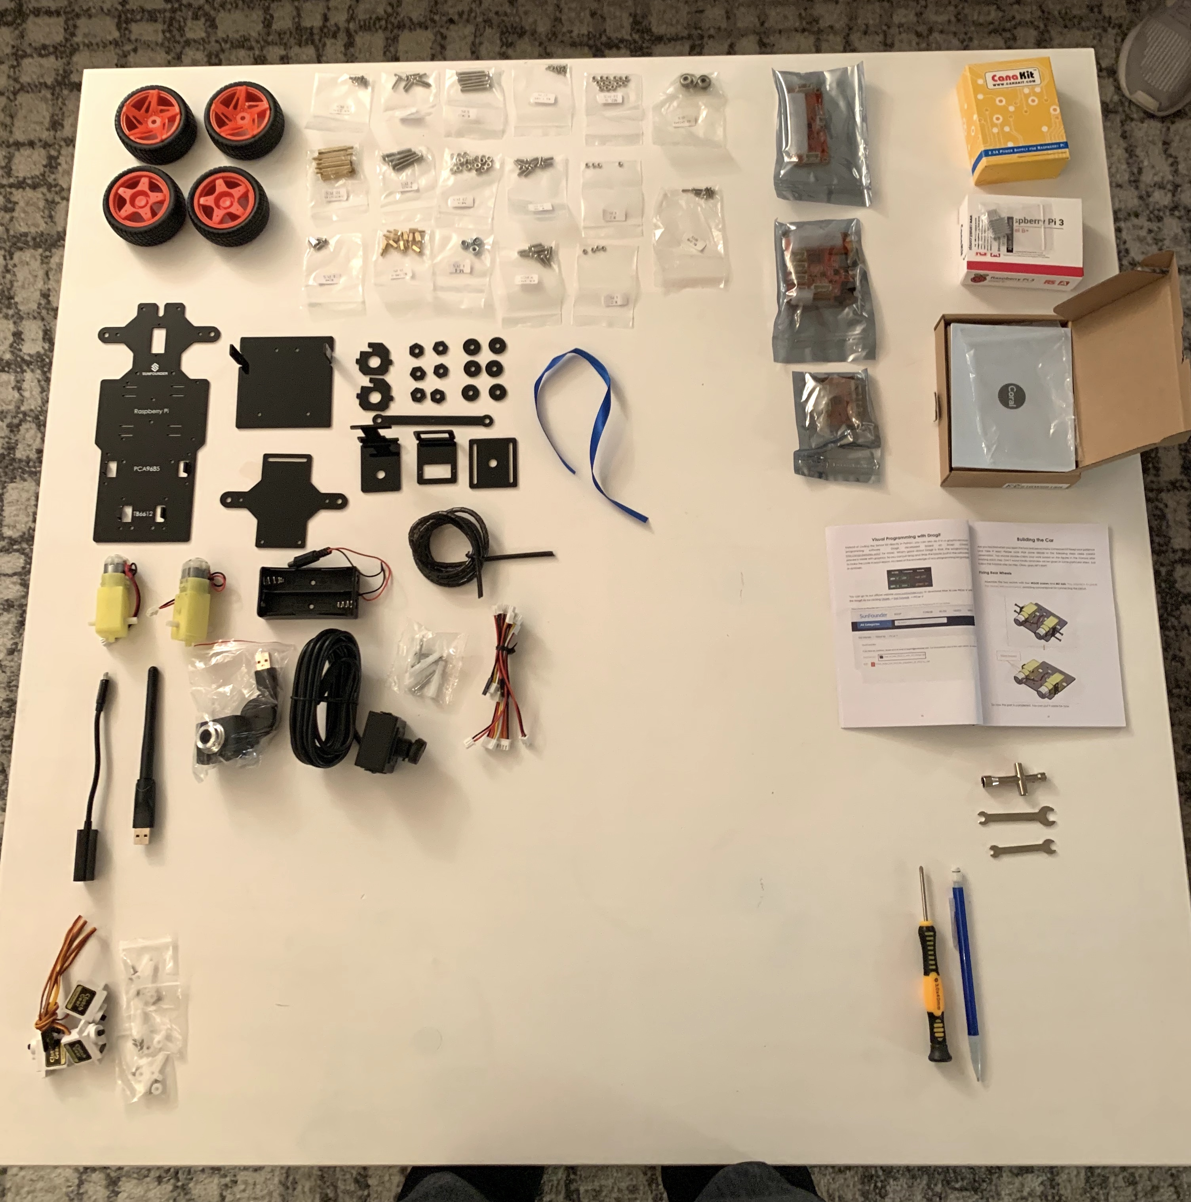
aiPiCar: hardware
Car Kit Used: SunFounder Smart Car Kit
CPU: Raspberry Pi 3 B+ (B Plus) Rasbpian Buster v. Sept 2019
Wide Angle Camera Upgrade: WLP Wide Angle USB Camera
CPU Upgrade: Coral EdgeTPU USB Accelerator
Laptop: Apple Macbook Pro Catalina v10.15.1

Slide 4

Initial Setup Challenges
New to Raspberry Pi Development
New Raspbian Version released recently (Buster)
Compatibilities with Buster, Python, OpenCV, Edge TPU
aiPiCar running via remote control

Slide 5
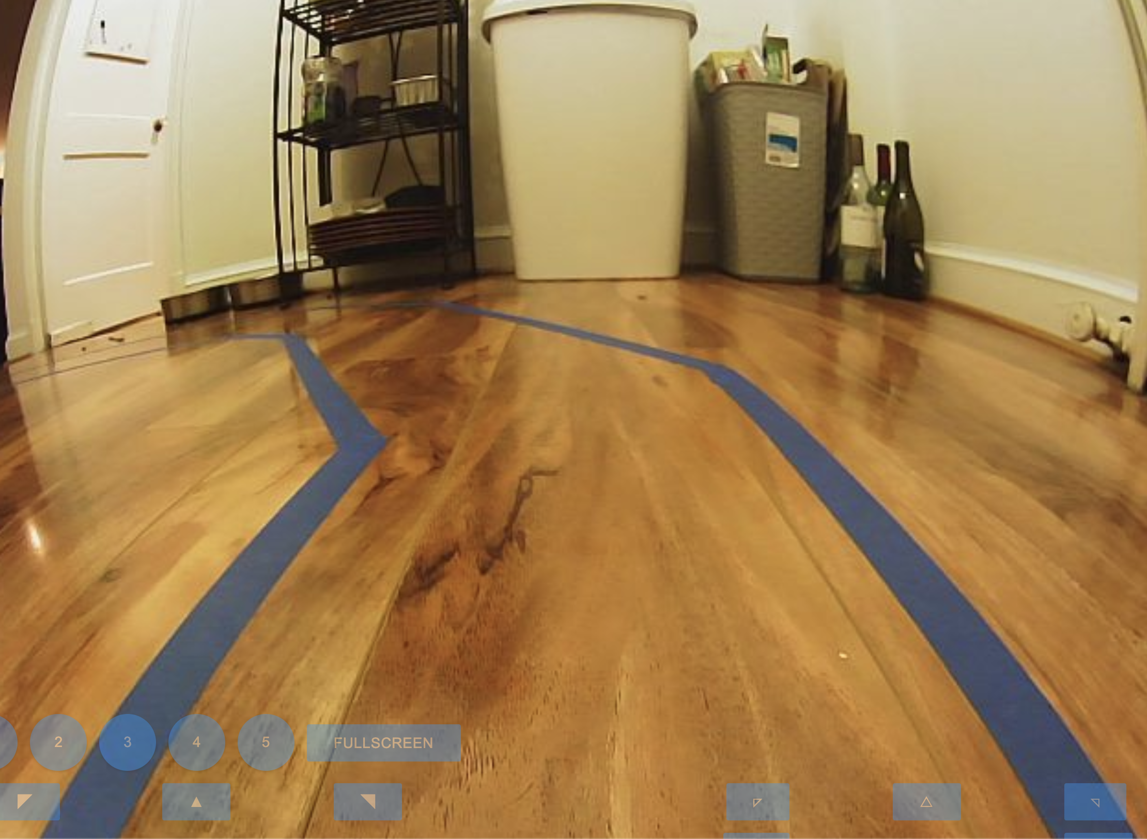
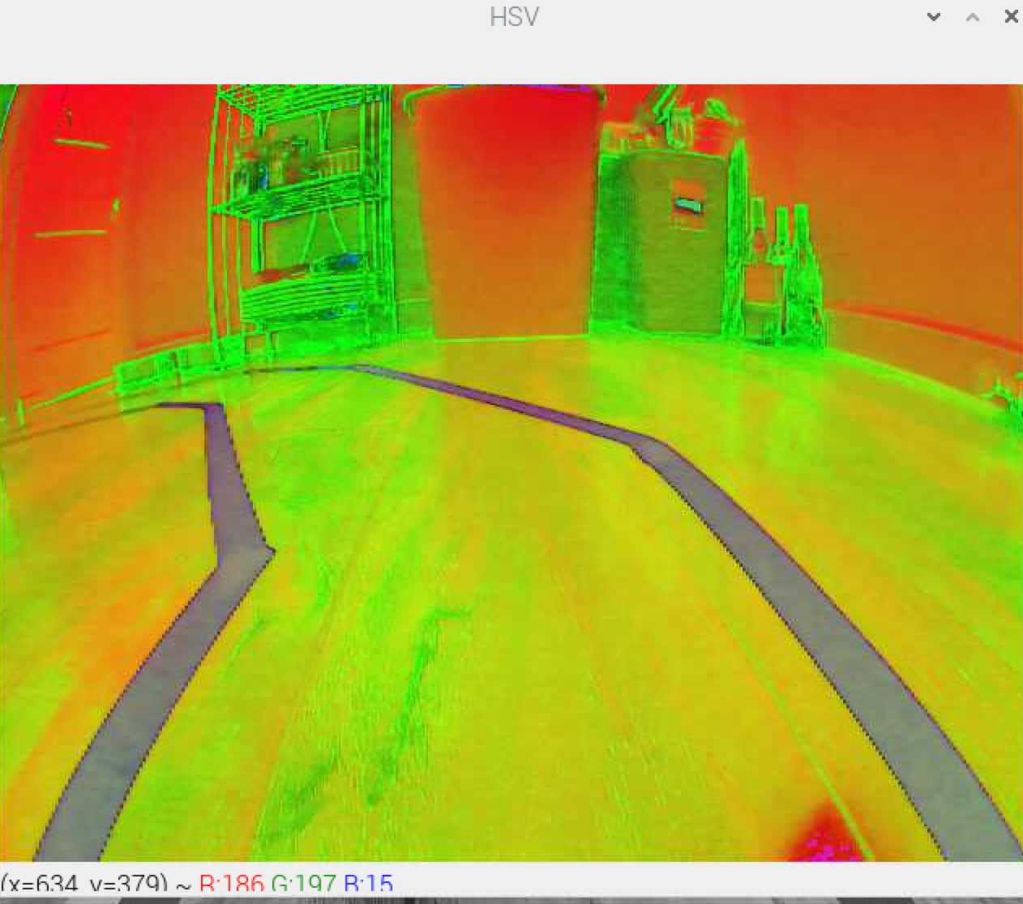
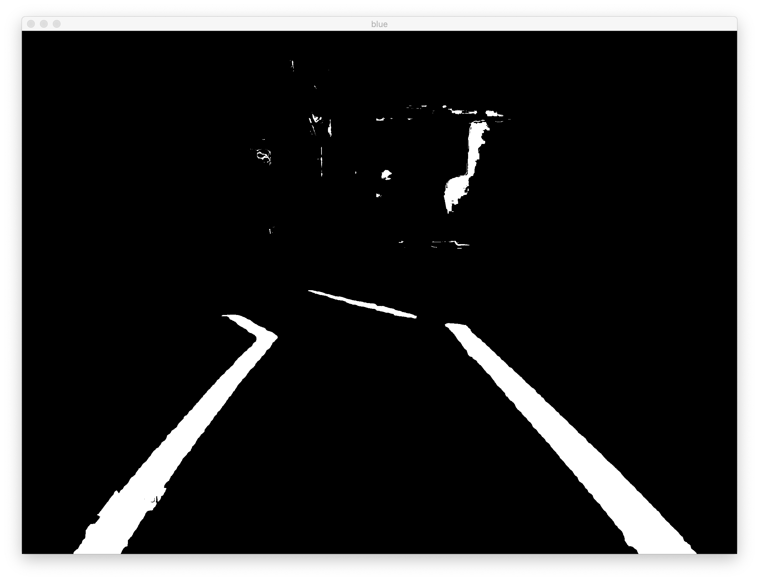
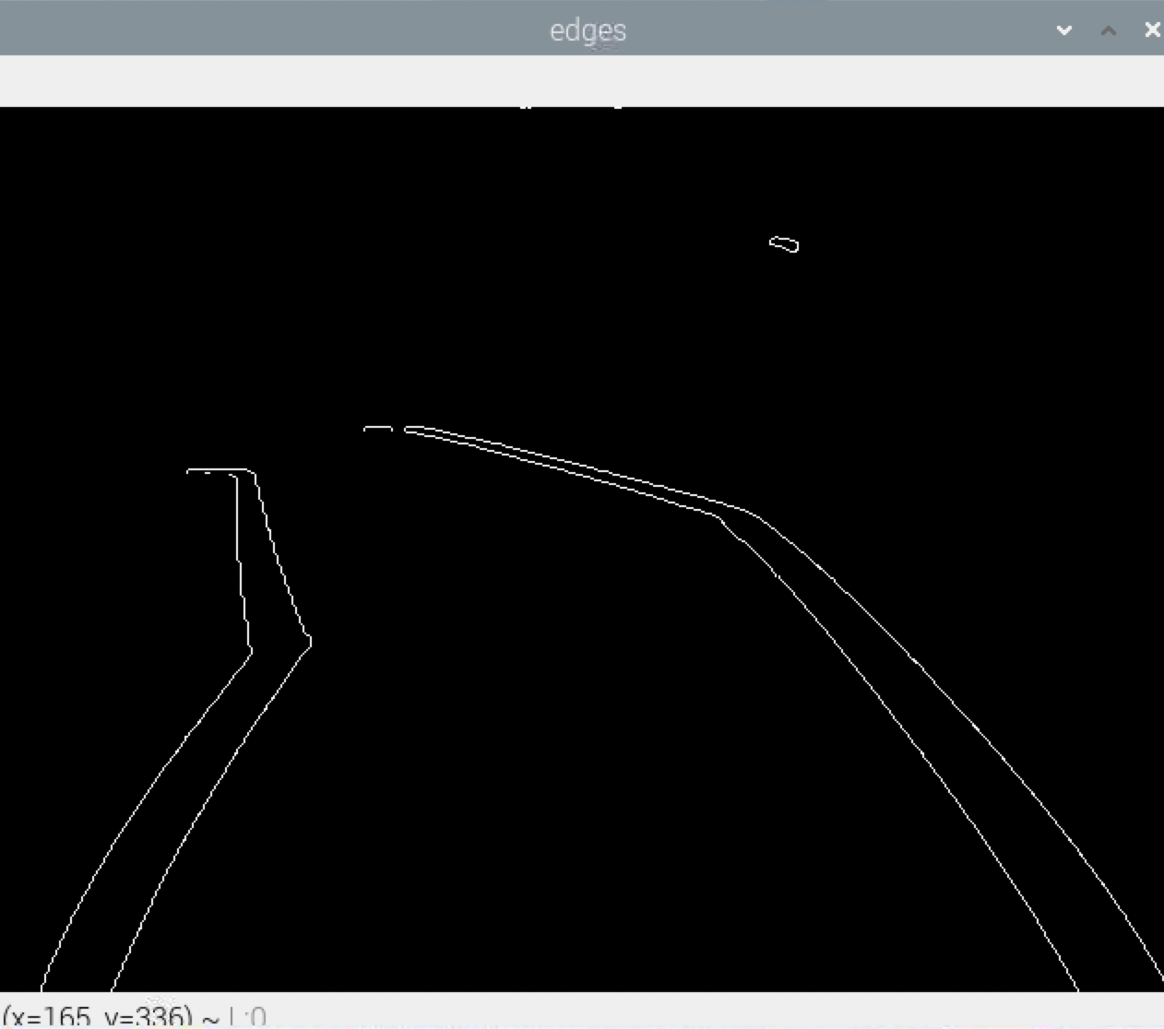
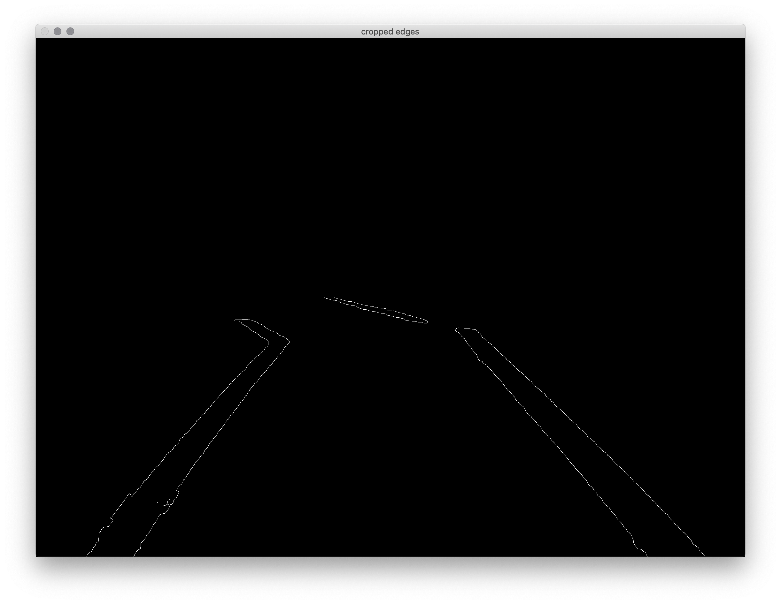
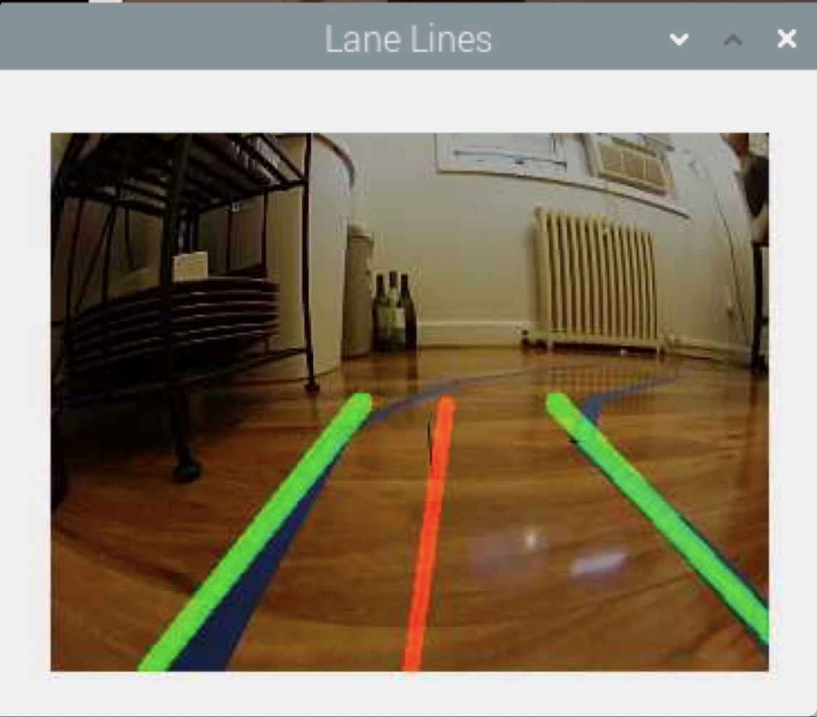
Lane Detection and Self Driving: OpenCV
Display Raw Video Stream
Apply HSV Color Filter
Apply Blue Color Mask
Detect Edges of Mask with Canny
Isolate Region of Interest (Lower Half of Image)
Detect Line Segments Using Hough Transform and Overlay Original Video

Slide 6
aiPiCar lane recognition with OpenCV

Slide 7
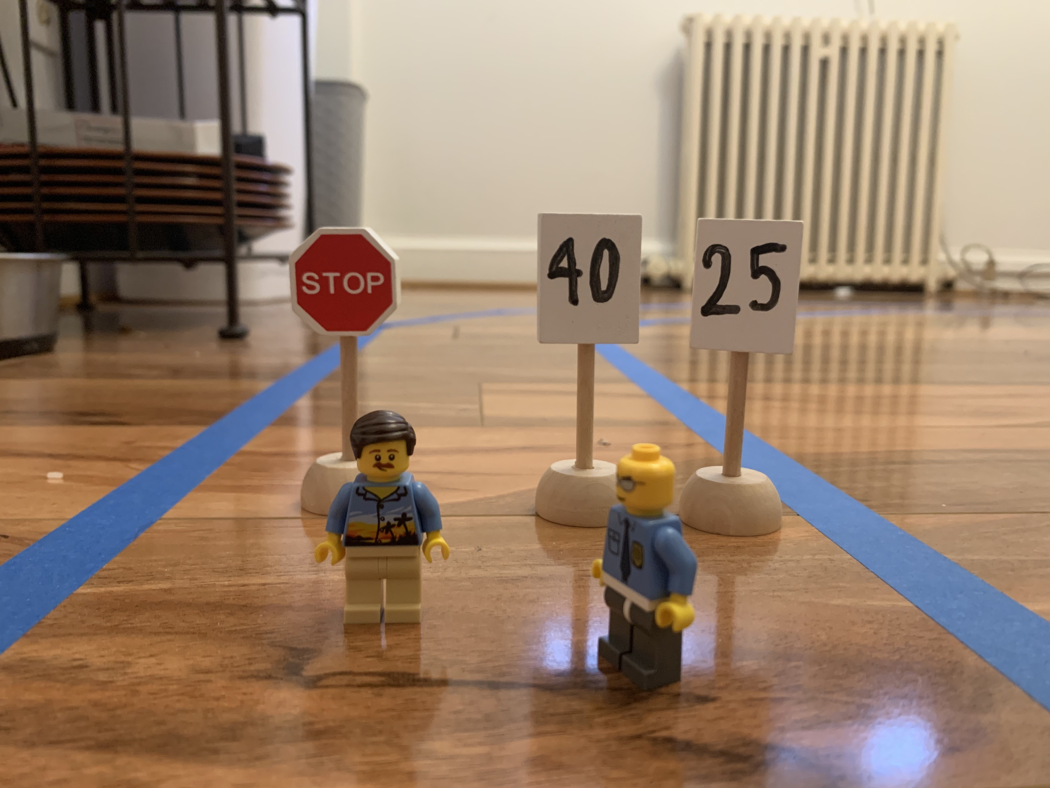
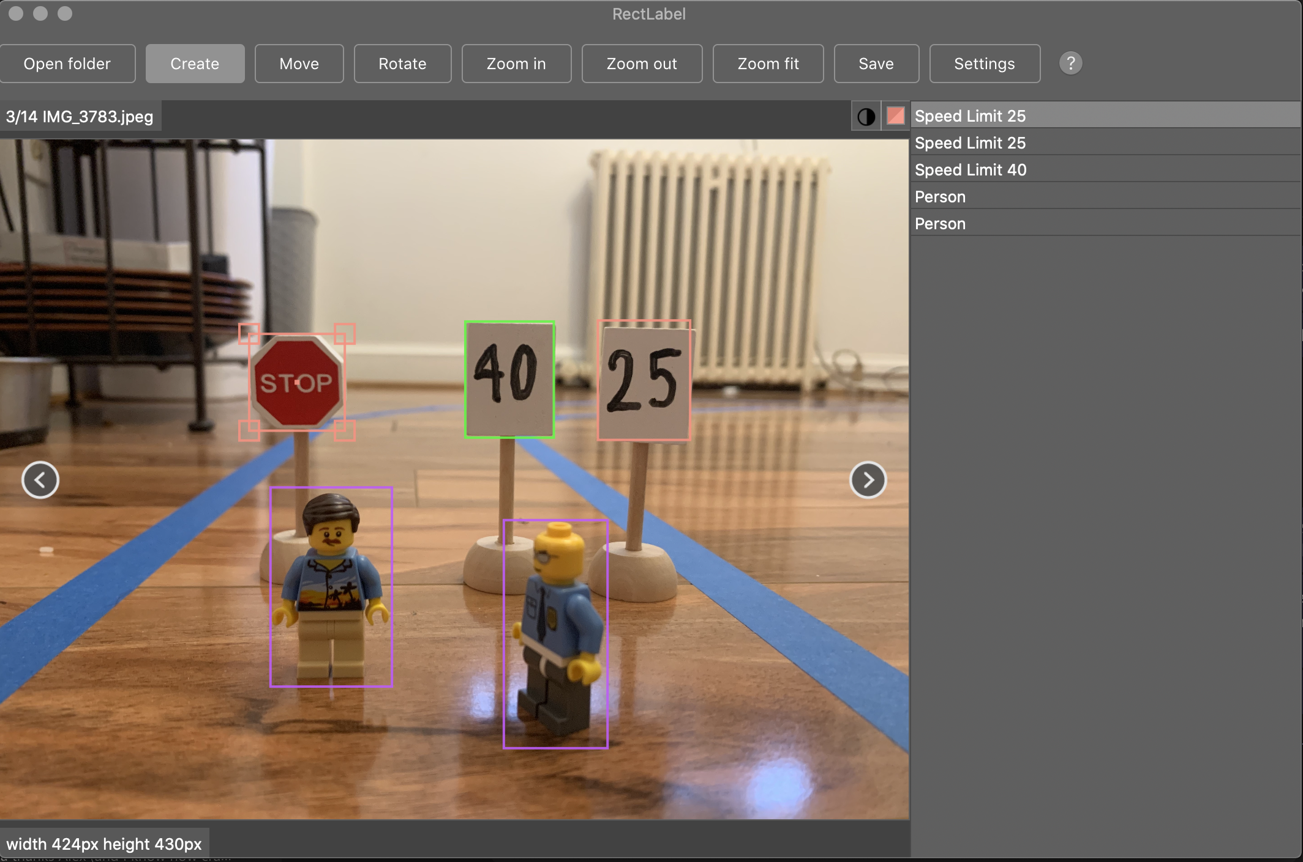
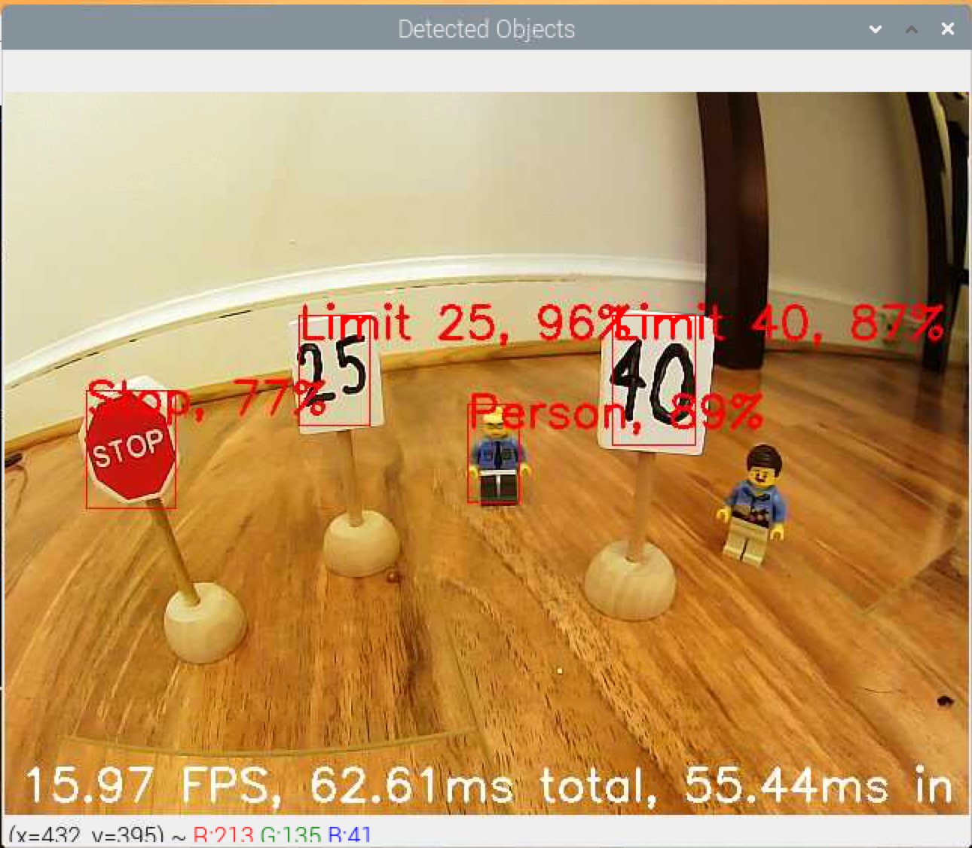
Sign Recognition and Obstacle Avoidance
Model Training:
Transfer Learning
MobileNet v2 SSD COCO Quantized
Image Capture and Labeling
Training with Collab Notebook
Conversion of Model to TensorFlow Lite flatbuffer file (Google Edge)

Slide 8
aiPiCar person detection
aiPiCar stop sign detection
aiPiCar speed limit detection

Slide 9
Aipicar Practical Demonstration: School Zone
Lane Following
Slow Down (25 mph sign recognition)
Stop for Pedestrian
Stop at Stop Sign
Speed Up (40 mph sign recognition)
AGH! Another Pedestrian!

Slide 10
Lessons Learned and Opportunities for Future Teams
RaspberryPi, macOS, EdgeTPU
Advanced Lane Following using Machine Learning
Current Model: OpenCV
Problems: Extremely sensitive (blue, lighting, noise)
Training Model based approach
Advanced Object Detection using End-to-End Machine Learning Approach
NVIDEA Paper Model: CNN training
Feed “Good Driver” Behavior Videos

